Slide 1

G-Research Crypto Forecasting
Team:
Veda Samhitha Alluri
Vishnu vardhan Ponduri

Slide 2
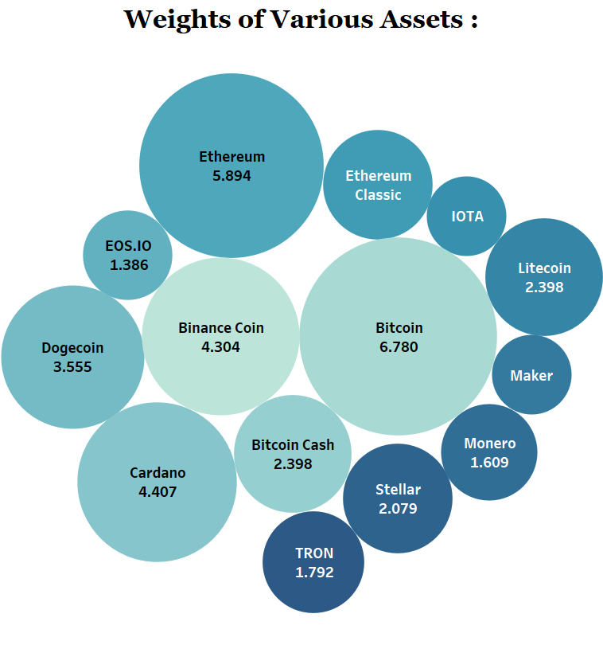



Cryptocurrency Data
Cryptocurrency :
A digital or virtual form of currency that uses cryptography for secure transactions and operates on a decentralized network using blockchain technology.
The first and most well-known
cryptocurrency is Bitcoin, created
in 2009.

Slide 3
Minute bar data features
Timestamp - A timestamp for the minute covered by the row.
Asset_ID - An ID code for the crypto asset.
Identifier
Count - The number of trades that took place this minute.
Open - The USD price at the beginning of the minute.
High - The highest USD price during the minute.
Low - The lowest USD price during the minute.
Close - The USD price at the end of the minute.
Volume - The number of crypto asset units traded during the minute.
VWAP - The volume weighted average price for the minute.
Target - 15 minute residualized returns.
Input
Output
Data:
14 Crypto assets from Jan 2018 to Jan 2022.

Slide 4
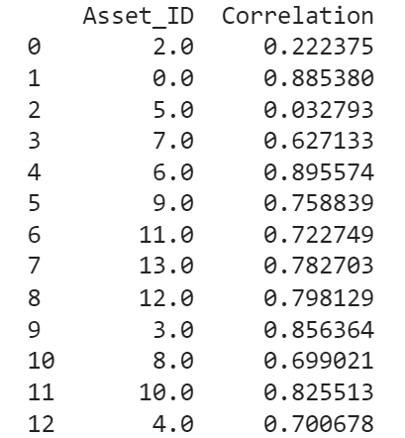




Objective
Predicting Target prices of bitcoin 15min into the future using I diverse set of stocks.
Co-relation : A statistical measure that indicates the extent to which two variables fluctuate together. A positive correlation means that as one variable increases, the other tends to increase as well; a negative correlation indicates that as one variable increases, the other tends to decrease.
We selected three assets - Bitcoin, Ethereum, and ESO.IO for our analysis. Our goal is to forecast Bitcoin's movements by leveraging Ethereum, which shows a strong correlation, and ESO.IO, which demonstrates a weaker correlation.

Slide 5





Methodology
Training and testing LSTM Model
Handling nulls and missing minute data
Exploratory
Data Analysis
Feature Engineering
Functions to input data into the LSTM Model
Provide insights into the distribution and trends of stocks over time,
co-relation between stocks, time –series decomposition.
Creating new features which capture the temporal attributes
Training the output and performing hyper-parameter tuning to better the model.
Preparing running window
Pre-Processing

Slide 6
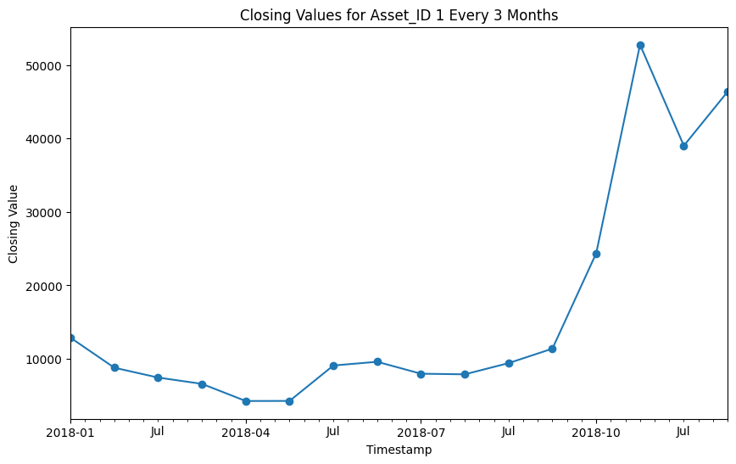
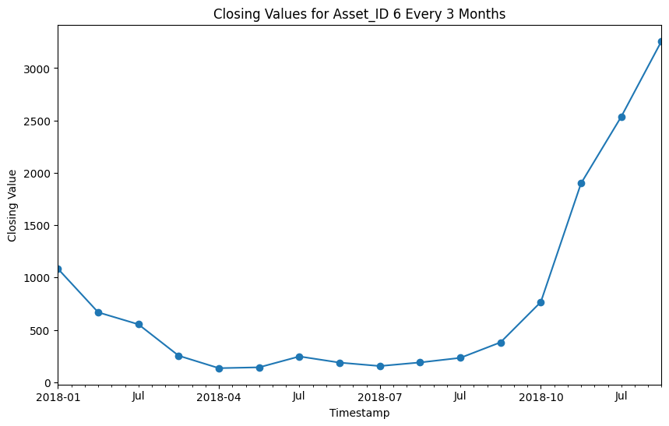
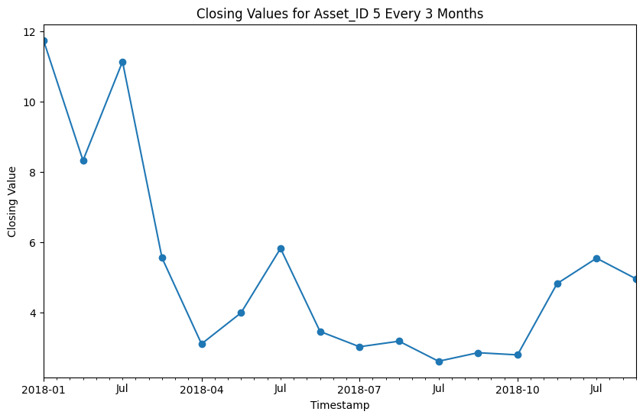
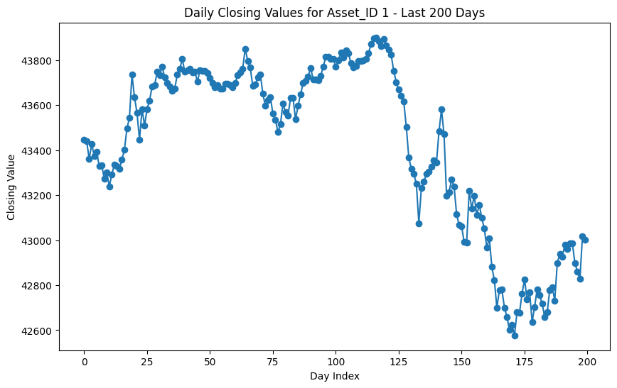
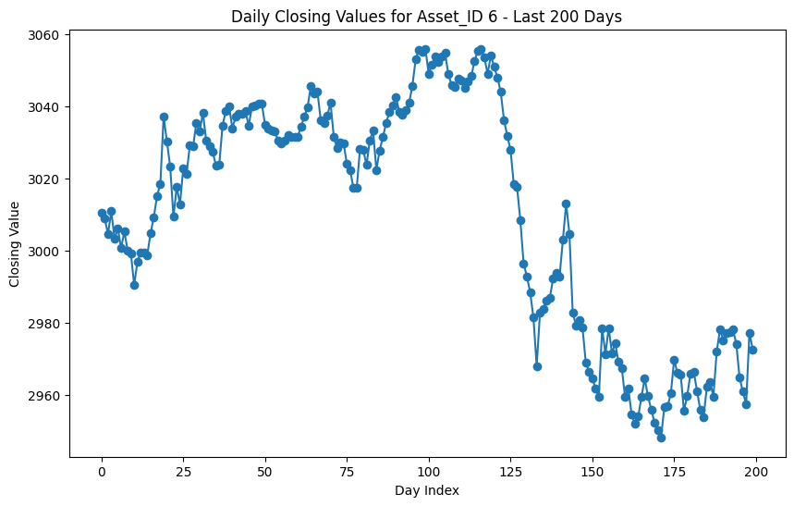
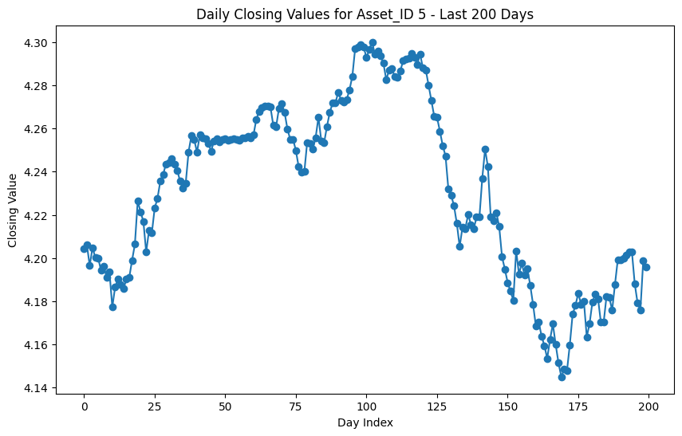
Closing Values for selected Asset ID's (Every 3 months & Last 200 days)
1 - Bitcoin
6 - Ethereum
5 - EOS.IO

Slide 7
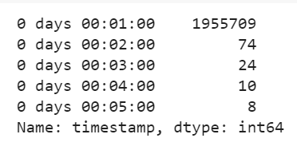
Data Preprocessing
Handling Missing Values : Using forward filling the missing data should be filled forward. This means that any missing value is filled with the last available non-null value, making the assumption that no significant change occurred in that one-minute interval.
Handling Missing Rows : If there were any missing rows (timestamps that did not exist in the original data), these are now included with NaN values for their data columns, which are then forward filled.

Slide 8
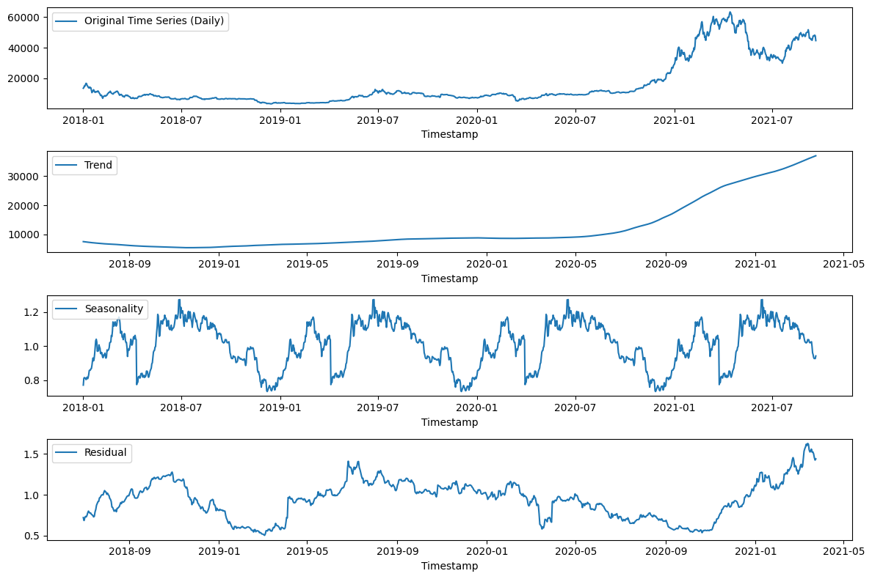
Time Series Decomposition : BTC Multiplicative = (Trend*Seasonality*residual)

Slide 9
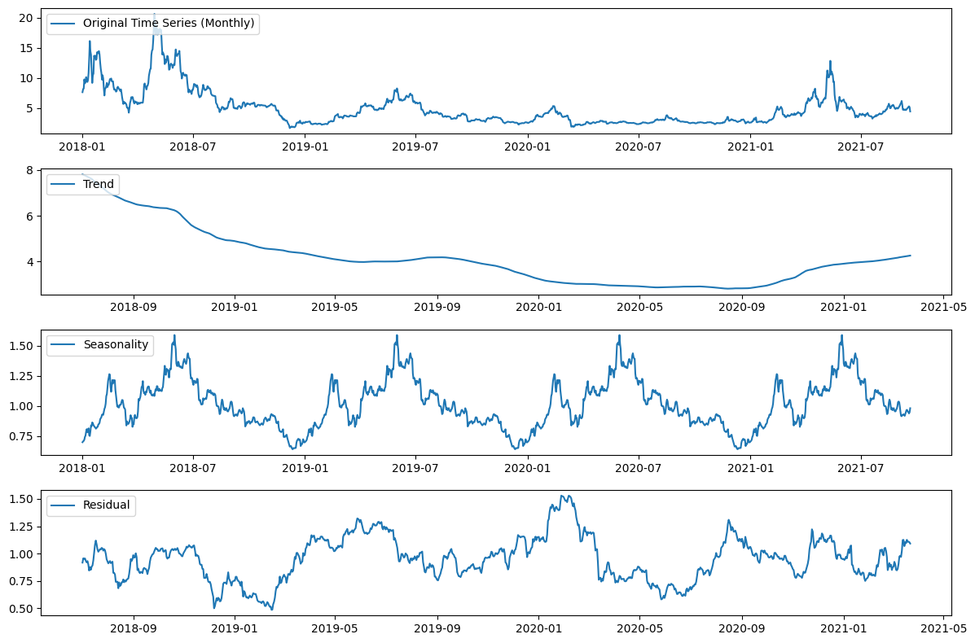
Time Series Decomposition : EOS Multiplicative = (Trend*Seasonality*residual)

Slide 10
Feature Engineering
Existing
High
New (to capture temporal features)
day
month
Time_sin
Low
Close
VWAP
Open
Volume
Time_cos
week

Slide 11
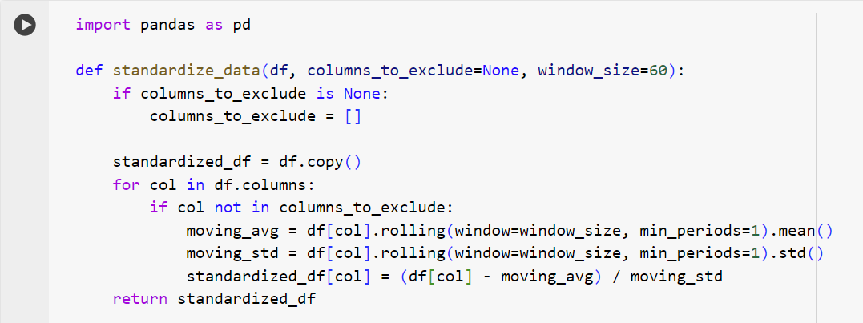
Local standardization
The process of normalizing the input data within each sequence individually, rather than across the entire dataset. This technique adjusts the data points within each specific sequence to have a standard scale before they are fed into a model.
This was chosen instead of min-max scaling

Slide 12
Input Preparation
Window Generator
Split window
Make dataset
Wide Window
Initialising a class to store raw data with parameters for input width, label width and shift
Splitting the features into input and target, sets the shape for further use
Converts the input data into Tensor flow timeseries dataset by mapping the split_window function to dataset
Creates a WindowGenerator instance (wide_window) with extended input and label widths

Slide 13


Combining the tables to feed into the model
TIMESTAMP
Feature_1 | Feature_2 | Feature_3 | Feature_4
Assets
TIMESTAMP
Feature_11 | Feature_12 | Feature_21 | Feature_22 | ……… | Feature_31 | Feature_32
Feature_1 | Feature_2 | Feature_3 | Feature_4
Input Shape
Feature_1 | Feature_2 | Feature_3 | Feature_4
Assets
Duration
Features

Slide 14
Rolling window of the input for LSTM​
Assets
TIMESTAMP
Sequence length: 60,45,90
Input range : [0 to 59]
Output range : [ 1 to 60]
Overlapping sets

Slide 15
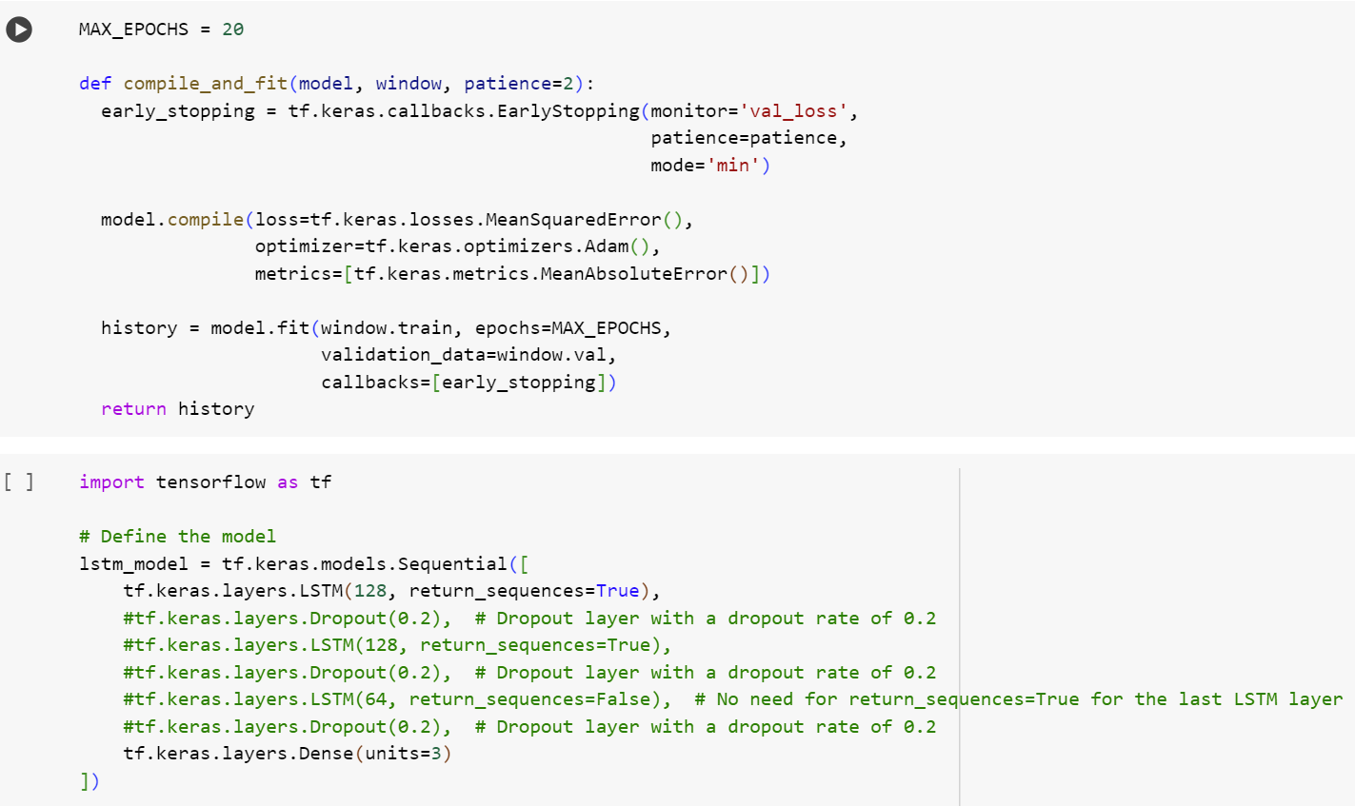
LSTM Model
We are training a TensorFlow LSTM model with early stopping, compiling it with mean squared error loss and Adam optimizer, and evaluating it using mean absolute error, over a maximum of 20 epochs.
We're using TensorFlow to define an LSTM neural network model with a 128-unit LSTM layer that returns sequences and concludes with a dense output layer of 3 units.

Slide 16
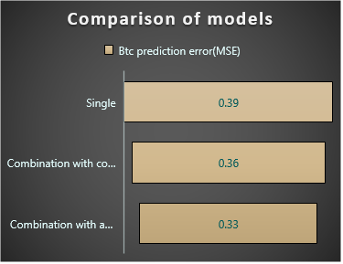
Prediction output
Increase in sequence length did not necessarily decrease the prediction error.
As expected, a diverse set of stocks were able to generalise the model better than the model only with co-related stocks.

Slide 17
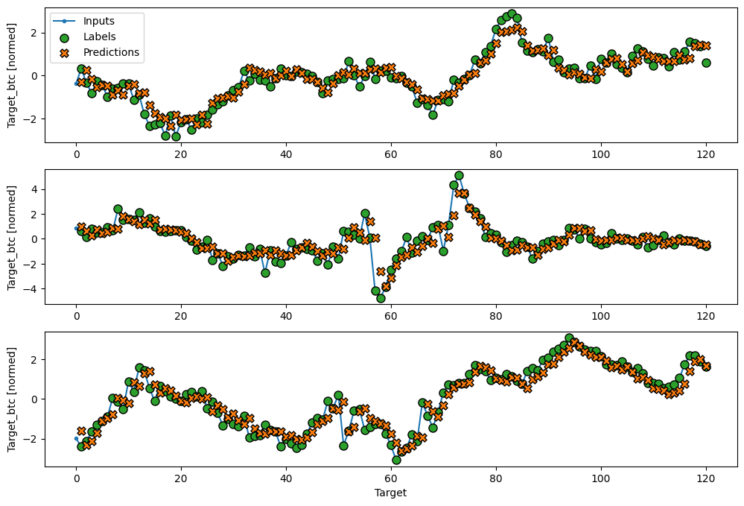
Prediction output

Slide 18
Recommendations
What else we could have done
What we could learn further
Ensemble models could be deployed for better predictions ( could be different LSTM models or different algorithms altogether).
Ensemble models if the co-relation between those models of different sequence length are small.
Self-attention to focus on certain time steps or features that are more relevant to prediction at hand.
Meta Learning for adaptive forecasting- Training on various time series datasets, enabling them to quickly adapt and handle diverse patterns.
Higer length of sequence doesn’t neccesarily guarantee better accuracy.
Cross validation (say 3-fold could have been used to generalise the model better.

Slide 19
Thank You
Purdue Business Analytics & Information Management
Machine Learning

